Slide 1
Covid-19 Vaccines Analysis
Phase-3

Slide 2
Items in the dataset:
Countries
Dates
Vaccines
Total Vaccinations
Desired data to find:
Most commonly used vaccines in countries
Average daily vaccination count in countries -Number of countries where vaccines are used
Choropleth map of the most used vaccine

Slide 3
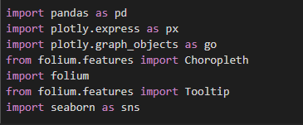
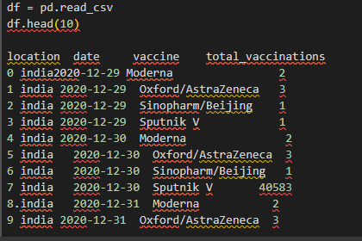

Slide 4
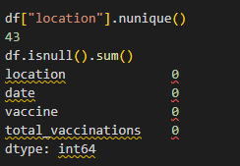
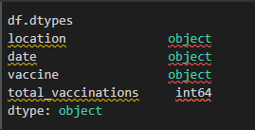

Slide 5
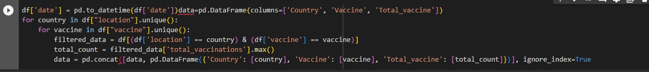
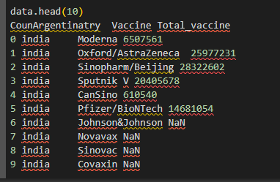

Slide 6
